Slide 1
For D – I Geography (Hon’s)
Paper – Physical Geography
BY
Dr. ALPNA JYOTI
Deptt. of Geography, Marwari College, Darbhanga
LNM University, Darbhanga

Slide 2
FACTORS CONTROLLING LANDFORMS : ENDOGENETIC & EXOGENETIC FORCES ¼LFky:Ik ds fu;a=d dkjd % vkUrfjd vkSj cká cy½

Slide 3
ENDOGENETIC & EXOGENETIC FORCES
HkwiVy ij ifjorZu ykus okyh “kfDr;kWa o cy dks vUrZtkr ,oa cfgZtkr cy dgrs gSaA
oSlk cy ftldh mRifr HkwiVy ds vUnj ls gksrk gS] vUrZtkr cy dgykrk gSA tSls& HkwdEi] Tokykeq[kh]
oSlk cy ftldh mRifr HkwiVy ds mij ghs gksrk gS] cfgZtkr cy dgykrk gSA tSls& unh] fgekuh] iou] leqnzh ygj vkfnA
cfgZtkr cy
vkUrfjd cy

Slide 4
THREE MAIN CAUSES OF ENDOGENETIC FORCES
i`Foh ds vkUrfjd Hkkx esa rkih; fo’kerk
¼ Thermal extrimity in earth’s interior½
i`Foh ds vkUrfjd Hkkx esa pêkuksa dk QSyko ,oa fldqM+u
i`Foh ds vkUrfjd Hkkx esa rjy o v)Zrjy inkZFkksa dk LFkkukUrj.k

Slide 5
ENDOGENETIC FORCES
vUrZtkr cy ¼ Endogenetic Force½ ds nks izdkj
1½ iVyfo:i.kh cy ¼Diastrophic Force½
2½ vkDlfed vUrZtkr cy ¼Sudden Endogenetic Force½

Slide 6
ENDOGENETIC FORCES
The force that comes from the earth’s interior due to any cause is called indogenetic force.
‘Volcanic eruptions and seismic events are also the expressions of endogenetic force but such movements are called sudden movements and the forces responsible for their origin are called sudden forces.
Diastrophic force : Both vertical and horizontal movements which disfigures the earth’s crust and are caused due to forces deep within the earth are called diastrophic force also known as constructive force. It is very slow and their effect become discernible after millions of years. It covers larger areas of the globe.

Slide 7
ENDOGENETIC FORCES (vUrZtkr cy)
iVyfo:i.kh cy ¼Diastrophic Force½
Epeirogenetic Force (egkns”k fuekZ.kdkjh)
Upward force
Downward force
Orogenetic force (ioZr fuekZ.kdkjh)
Tension & Compression

Slide 8
ENDOGENETIC FORCES (vUrZtkr cy)
Orogenetic Force
(ioZr fuekZ.kdkjh cy)
Tension (ruko)
Cracking
Faulting
Compression
(lEihMu cy)
Warping & Folding

Slide 9
ENDOGENETIC FORCES (vUrZtkr cy)
Compression
(lEihMu cy)
Warping (laoyu )
Upwarping
Downwarping
Folding (aoyu )

Slide 10
ENDOGENETIC FORCES-FOLDING
(vUrZtkr cy&&oyu)
SYMMETRICAL FOLD
(lefer oyu)
ISOCLINAL
FOLD
(leur oyu)
PLUNGING
FOLD
(voueu oyu)
FAN
FOLD
(Ika[kk oyu)
RECUMBENT FOLD
(ifjoyu)
ASYMMETRICAL
FOLD
(vlefer oyu)
MONOCLINAL
FOLD
(,dur oyu)
OVERTURNED
FOLD
(leizfr oyu)
OPEN & CLOSED
FOLD
([kqyk ,oa cUn oyu)

Slide 11
FOLD (oyu)
Wave-like bends on the crustal rocks due to tangential compressive force resulting from horizontal movement caused by indogenetic force originating deep within the earth is known as fold.
Indogenetic force originating deep within the earth horizontal movement
compressive force crustal rock bends resulting in the shape of wave like bends known as fold.

Slide 12
FOLD (oyu)
In fold, some parts are bent up and some parts are bent down.
Up folded rock strata are called ‘Anticlines’ while the down fold structure in the shape of trough like feature is called ‘Synclines’.
Two sides of a fold are called ‘Limbs of the fold’.
The limb shared 1.

Slide 13
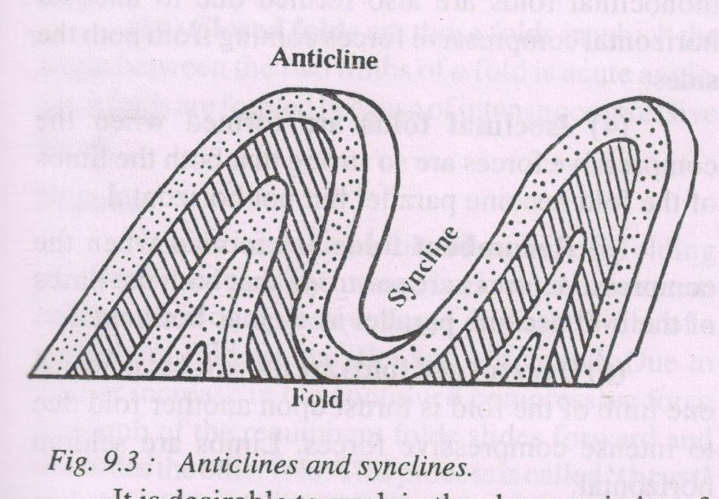
ANTICLINE & SYNCLINE

Slide 14
FOLD (oyu)
Horizontal forces and movements are known as tangential force.
The plane which bisects the angle between two limbs of anticline / middle limb of syncline is called axial plane or axis of fold.
Dip –The inclination of rock beds from the horizontal plane is called dip.
Strike –The direction of any horizontal line along a bedding plane is called strike.

Slide 15
ANTICLINORIUM & SYNCLINORIUM (leiufr ,oa lefHkufr)
Anticlinorium : Assembly of anticlines is called Anticlinorium. A series of minor anticlines in a extensive anticline is called Anticlinorium. (tc ,d foLr`r viufr esa vusd NksVs&NksVs viufr;ksa dk fuekZ.k gks tkrk gS] rks mls leiufr dgk tkrk gSA )
Synclinorium : Assembly of synclines is called Synclinorium. A series of minor synclines in a extensive syncline is called Synclinorium. (tc ,d foLr`r vfHkufr esa vusd NksVs&NksVs vfHkufr;ksa dk fuekZ.k gks tkrk gS] rks mls lefHkufr dgk tkrk gSA )

Slide 16
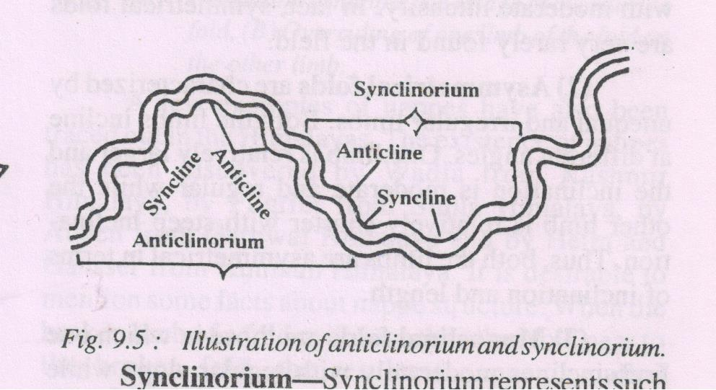
Anticlinorium & Synclinorium

Slide 17
TYPES OF FOLD (oyu ds izdkj )
Symmetrical Fold (lefer oyu ) – When both the limbs incline uniformly, the resultant fold is called symmetrical fold. It is an example of open fold but found rarely on in the field. When compressive force work regularly and with moderate intensity.
Asymmetrical Fold (vlefer oyu ) – When both the limbs incline unequal, irregular and at different angles, the resultant fold is called asymmetrical fold. One limb becomes larger and another becomes shorter. When compressive force work irregularly and with fluctuating intensity.

Slide 18
TYPES OF FOLD (oyu ds izdkj )
Monoclinal Fold (,dur oyu ) – When one of the limbs incline moderately with regular slope and the another limb inclines steeply or vertical or at right angle, the resultant fold is called monoclinal fold.
Isoclinal Fold (leur oyu ) – When compressive force becomes so strong, both the limbs of the fold become parallel but not horizontal, the resultant fold is called isoclinal fold.

Slide 19
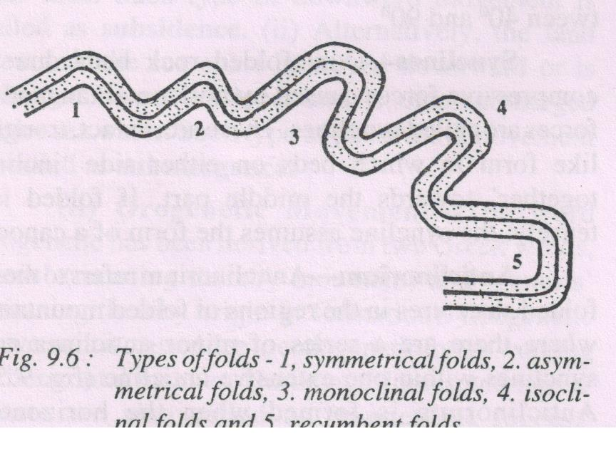
TYPES OF FOLD (oyu ds izdkj )

Slide 20
TYPES OF FOLD (oyu ds izdkj )
Recumbent Fold (ifjofyr oyu ) – When compressive force becomes so strong, both the limbs of the fold become parallel and horizontal, the resultant fold is called recumbent fold.
Overturned Fold (izfroyu ) – Due to intense compressive force, one of the limbs of the fold is thurst upon another and become parallel but not horizontal, the resultant fold is called overturned fold.

Slide 21
TYPES OF FOLD (oyu ds izdkj )
Plunge Fold (voueu oyu)–
When the axis of the fold instead of being parallel to the horizontal plane becomes tilted and forms plunge angle which is the angle between the axis and the horizontal plane.
Fan Fold (ia[kk oyu)–
It represents an extensive and broad fold consisting of several minor anticlines and synclines resembling a fan. Such feature is also called anticlinorium and synclinorium .

Slide 22
CLOSED & OPEN FOLD
(cUn ,oa [kqyk oyu)
Open Fold ([kqyk oyu)–
The fold in which the angle between the two limbs of the fold is more than 90⁰ but less than 180⁰ (obtuse angle between the limbs of the fold. Moderate nature of compressive force make open fold.
Closed Fold (cUn oyu)–
The closed fold are those in which the angle between the two limbs of a fold as acute angle (<90⁰). Such folds are formed because of intense compressive force.

Slide 23
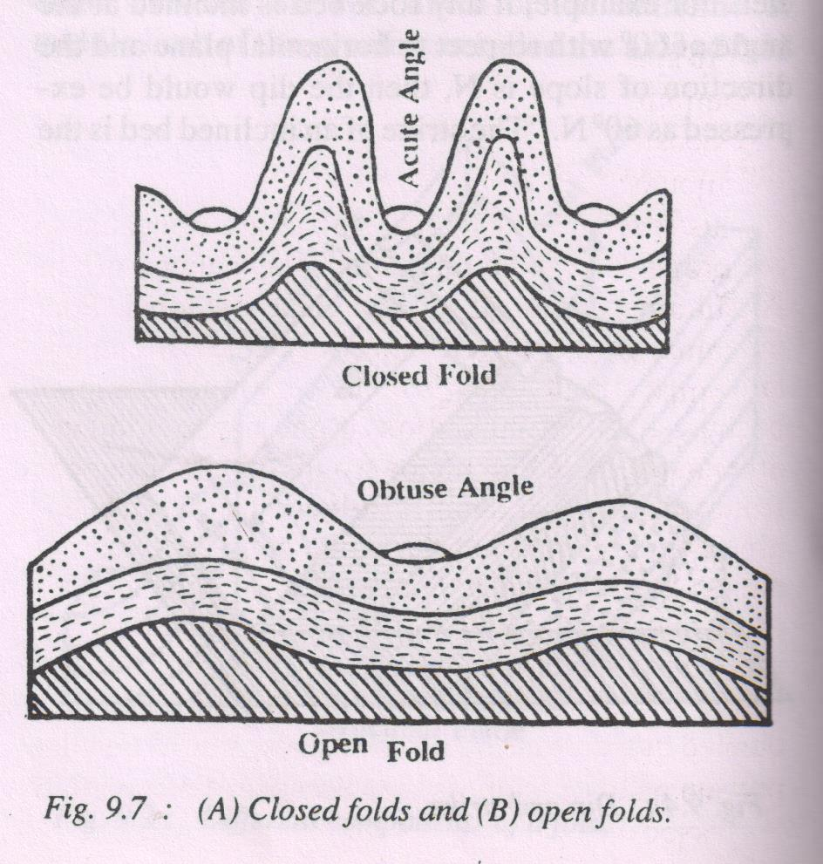
CLOSED & OPEN FOLD
(cUn ,oa [kqyk oyu)

Slide 24
NAPPES
Nappes are the result of comples folding mechanism caused by intense horizontal movement and resultant compressive force.
When the compressive force becomes so acute that it crosses the limit of the elasticity of the rock bed, the limbs of the fold are so acutely folded that these break at the axis of the fold and the lower rock beds come upward.

Slide 25
CLOSED & OPEN FOLD
(cUn ,oa [kqyk oyu)

Slide 26
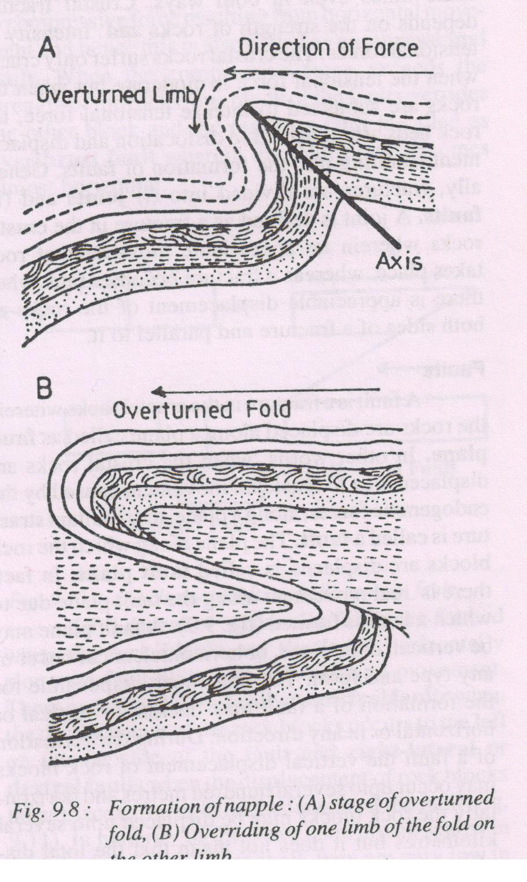
OVERTURNED FOLD

